Slide 1
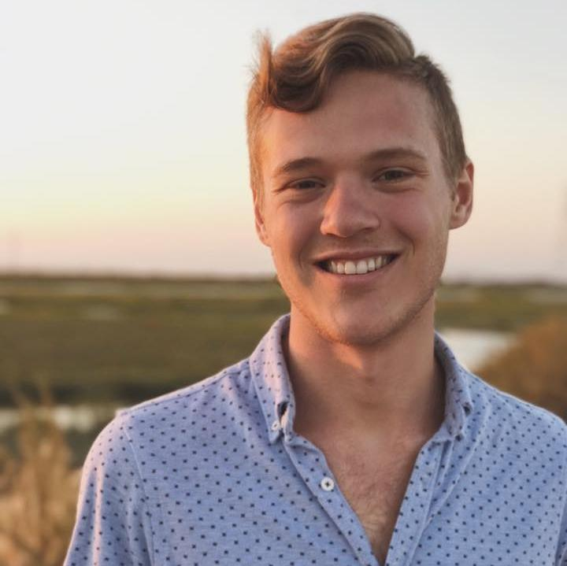
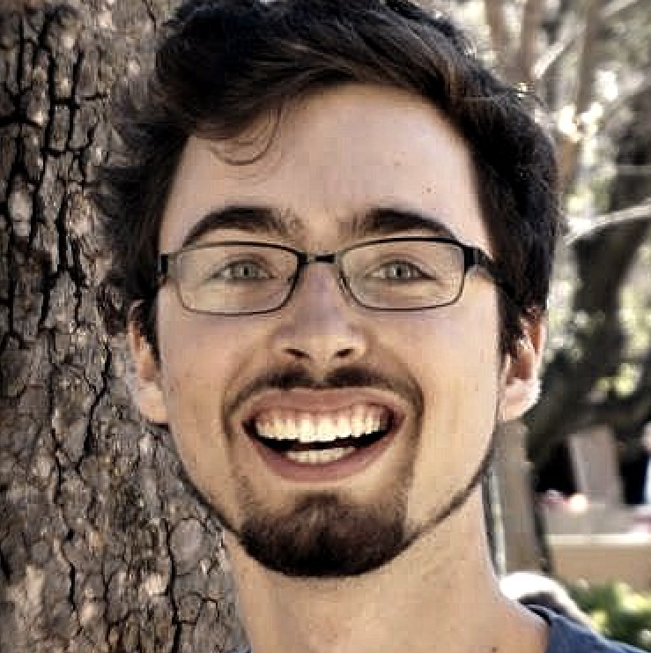
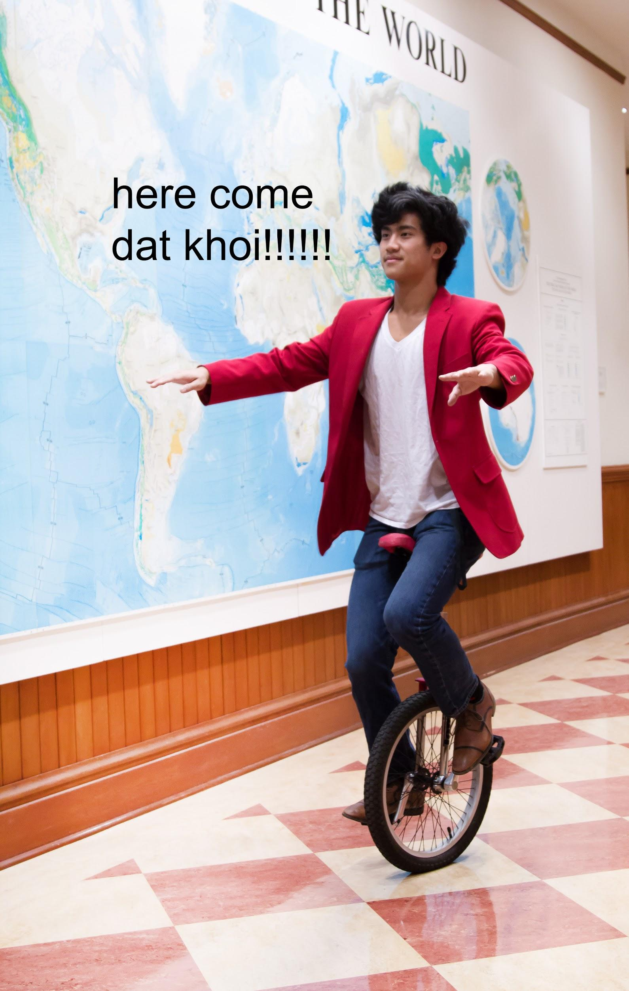
Stefan Swaans
B.S CS 2018
David Mora
B.S CS 2018
Khoi Le
B.S SymSys 2020

Slide 3
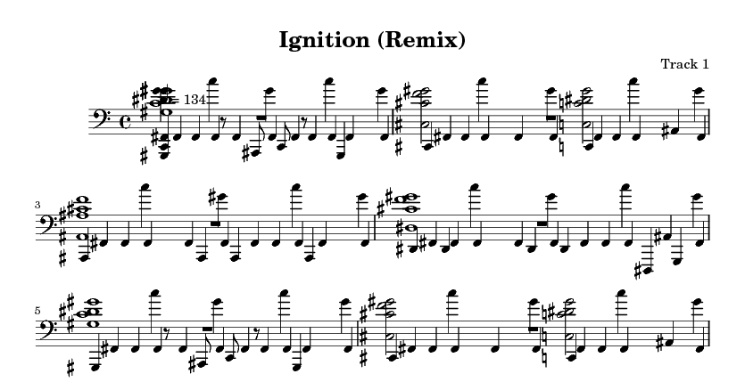

Slide 4
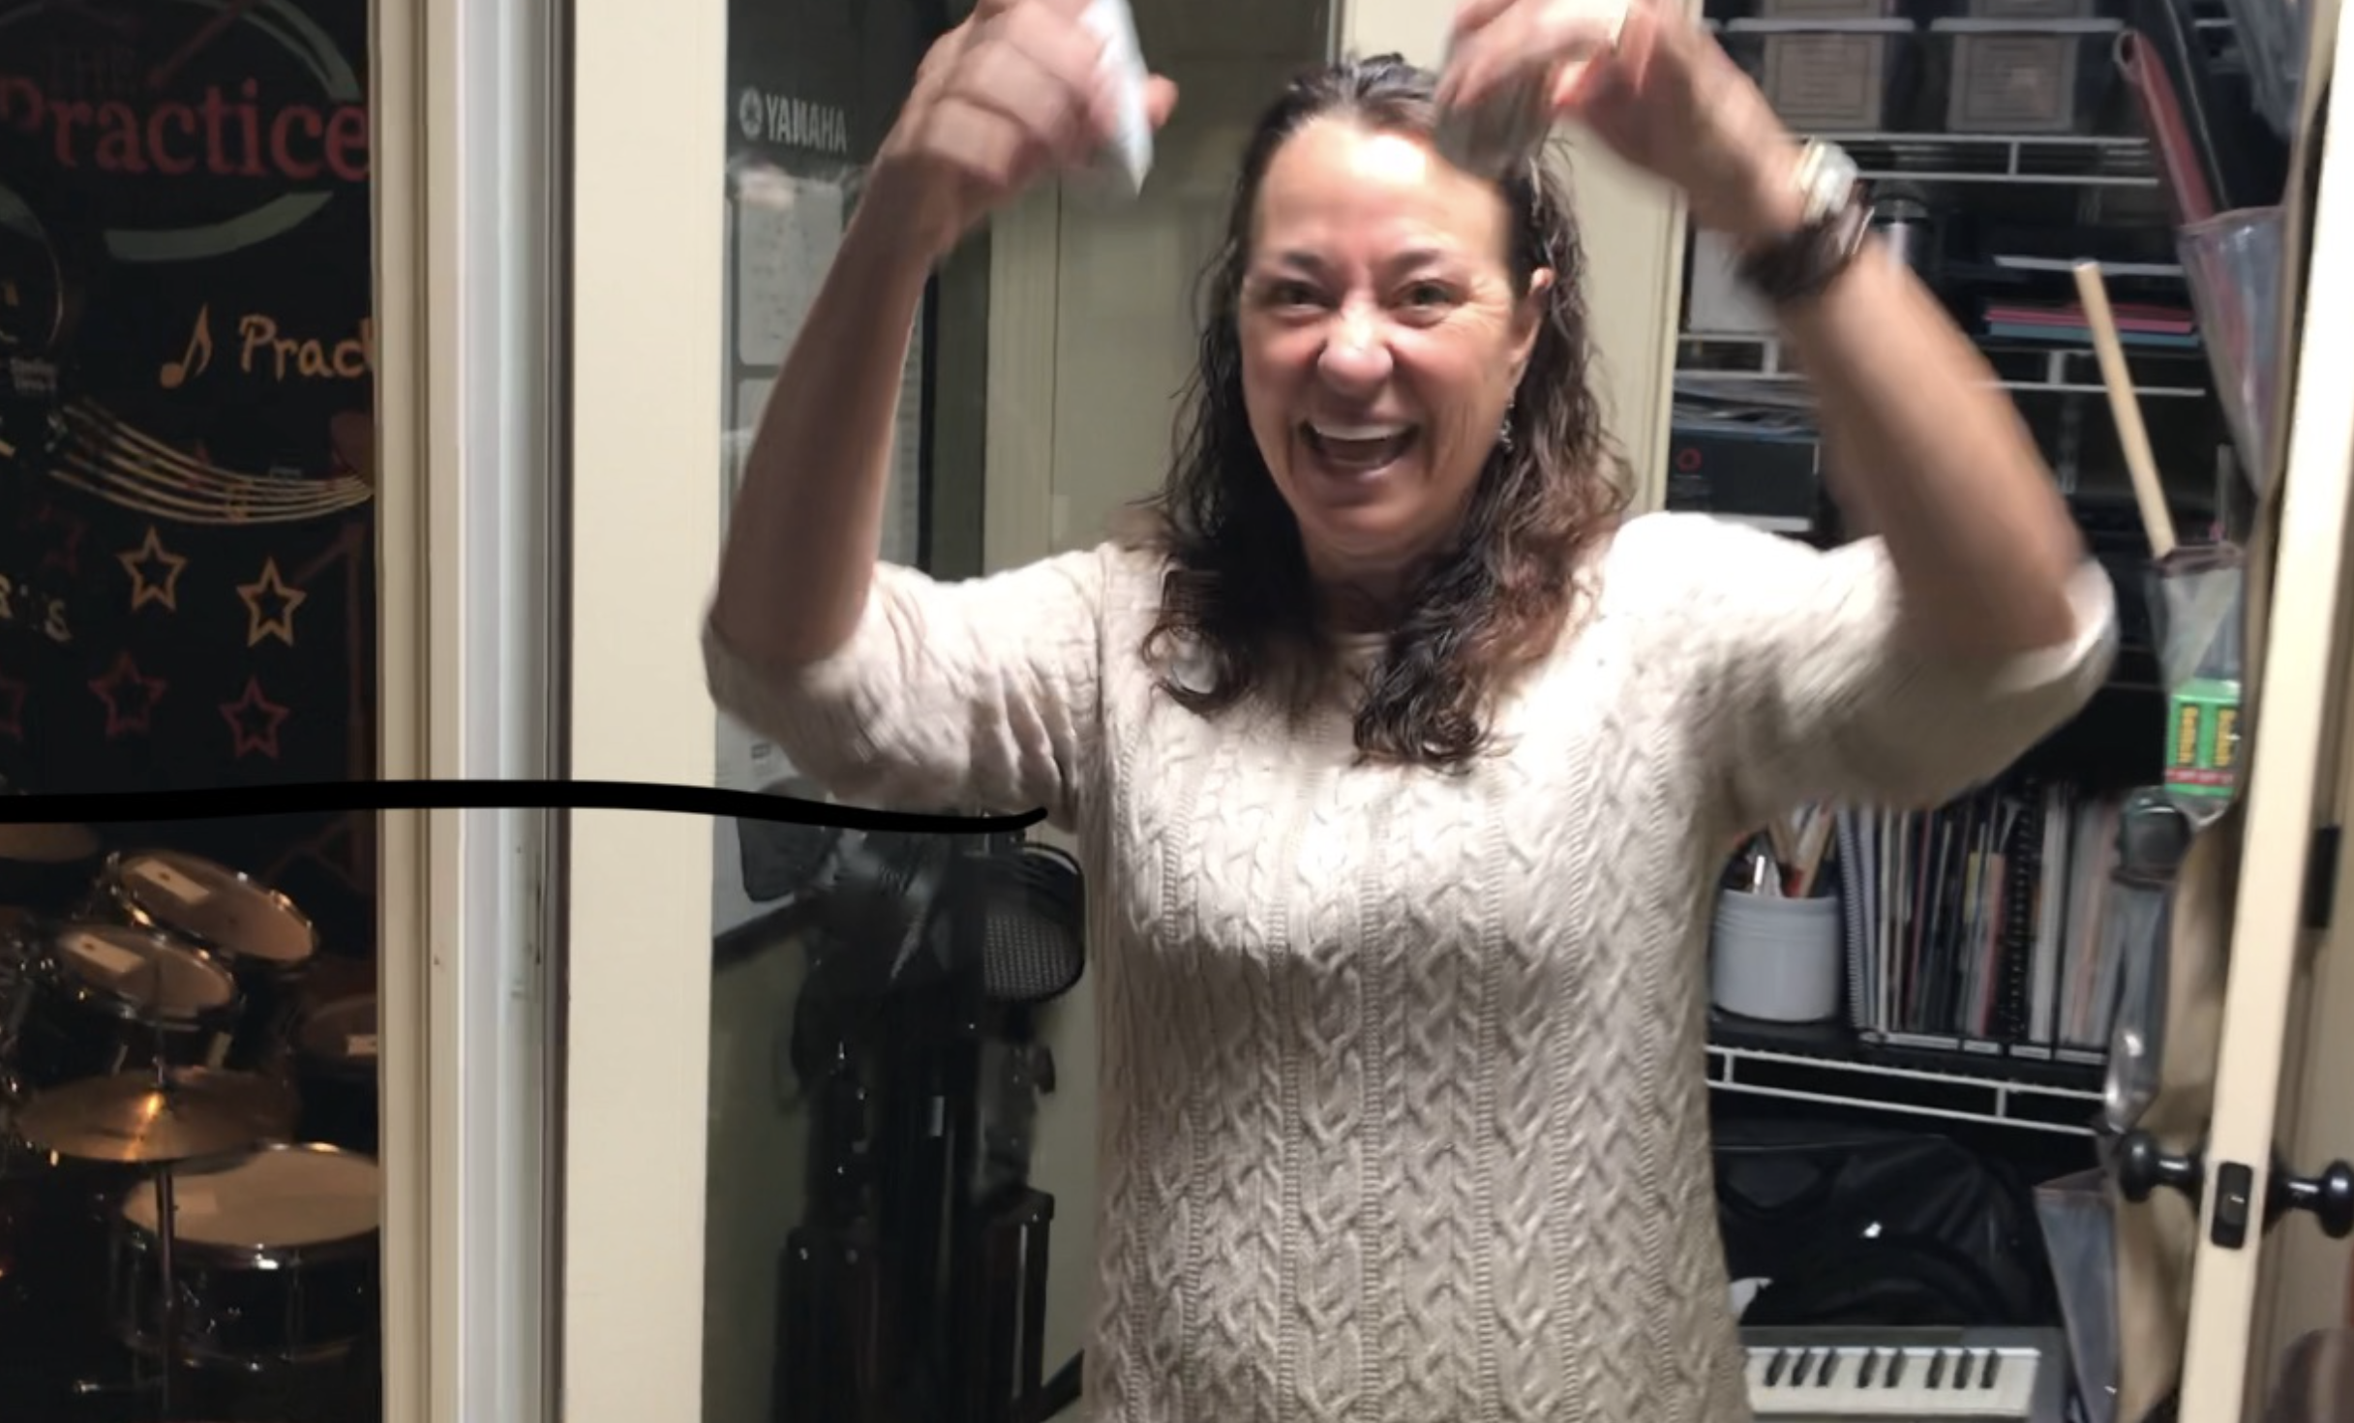
Sheri is a freelance drum instructor. She offers drum lessons both to kids and adults, and practices daily herself. With her experience in both learning and teaching, we considered her to be an excellent interviewee for needfinding. We interviewed Sheri in her home studio.

Slide 5
Questions
What does a typical day look like for you?
Why?
How do you get your students engaged in learning?
What do you think is important for students to stay motivated?
Can you walk us through how you practice?
Can you walk us through how you teach?

Slide 6



Results
“Addicted to Learning”,
Practice
Envisioning Goals
Approval leads to motivation

Slide 7
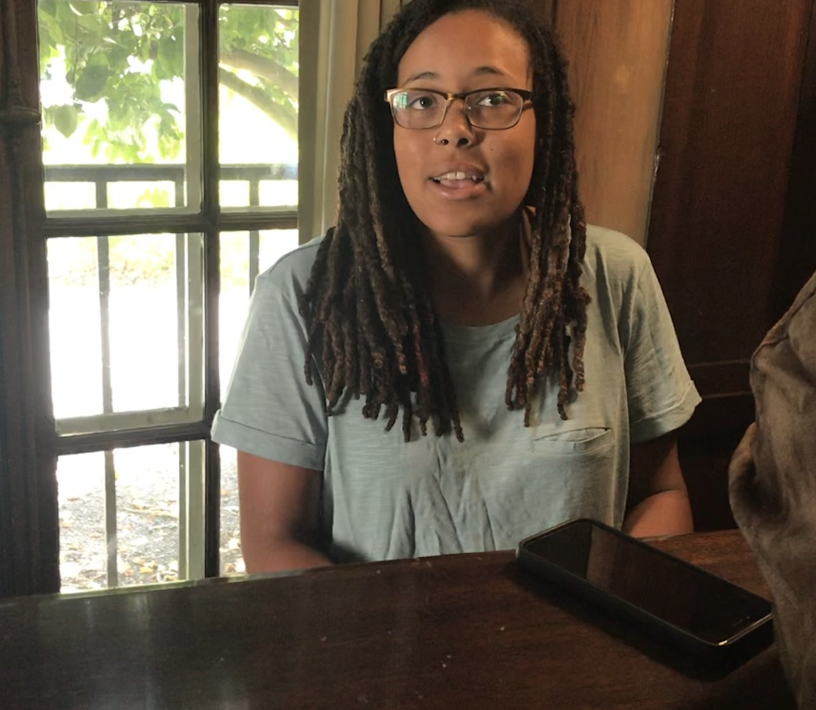
Michelle is a Stanford senior, multi-instrumentalist, singer, and freestyle rapper. She has had a rich musical journey, which made her a great candidate for our needfinding search. We interviewed Michelle here on campus.

Slide 8
Questions
Can you describe your musical journey?
Do you recall any especially formative moments?
What do you think fueled your continued interest in music?
When were you excited most about music?
Who were people you looked up to in your music journey?
Were there any failures along the way?

Slide 9

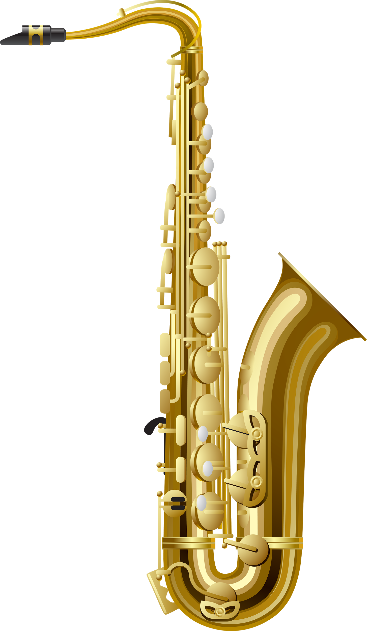

Results
Teamwork, enjoyment, emotion
Approval leads to motivation
Confidence
Notes:
Michelle’s interview results

Slide 10
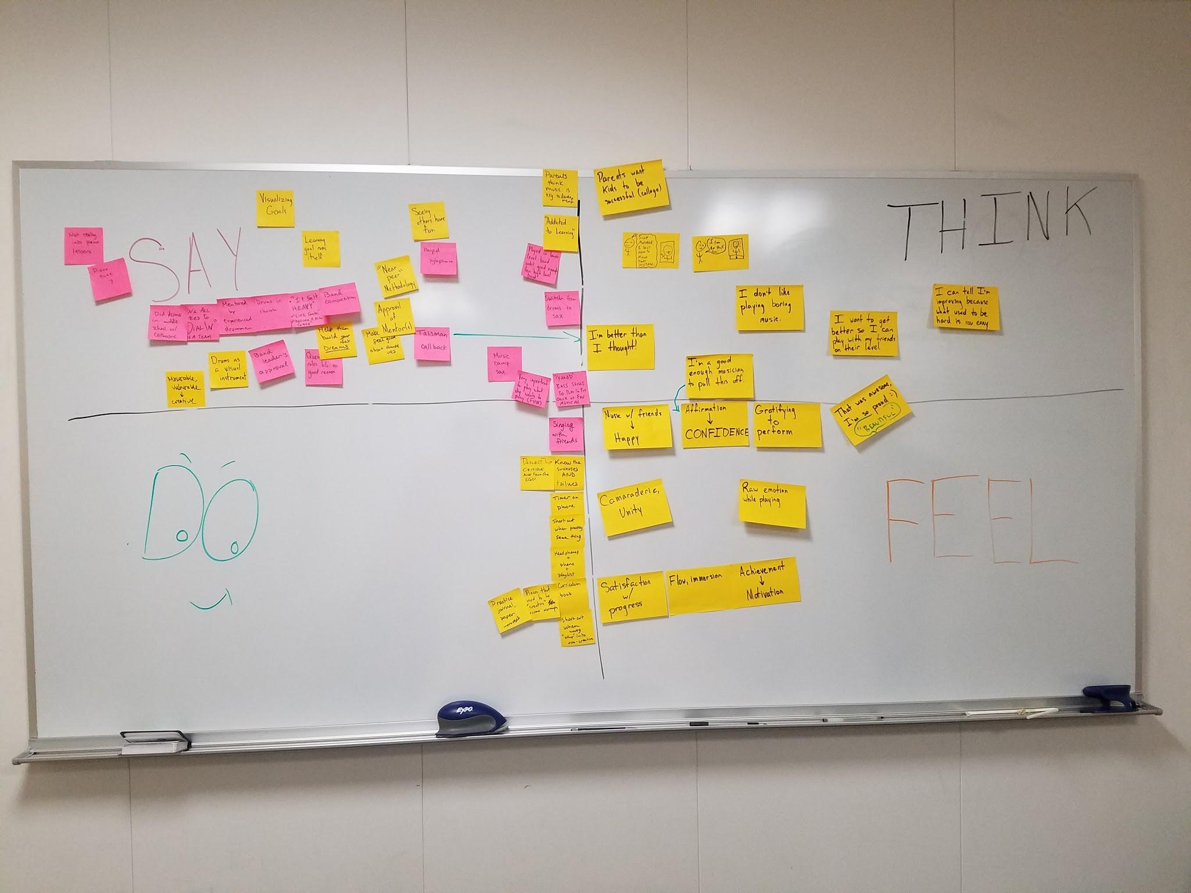
Insights

Slide 11


Slide 12


